Slide 1
E-COMMERCE DATA PROCESSING PIPELINE
A Medallion-Architecture ETL Pipeline on AWS
PySpark • Python • SQL • AWS S3 • AWS Glue • Power BI
Naimuddin Khan | Data Engineer

Slide 2
Executive Summary
Turning raw e-commerce data into governed, analytics-ready insight
This project implements an end-to-end data engineering pipeline that ingests, cleans, transforms, and analyzes e-commerce transactional data at scale — using a Medallion architecture (Bronze → Silver → Gold) built on AWS.
4
3
<15 min
<0.5%
Core data entities ingested
Medallion layers
Time to produce a revenue report
Data quality issues after cleaning
Orders, Customers, Products, Clickstream
Bronze (raw) → Silver (cleaned) → Gold (BI-ready)
Down from ~2 days manual (Excel)
Down from ~7% in raw source data
Objectives
Design a layered data lake separating raw, cleaned, and business-ready data
Build reusable, parameterized PySpark ETL jobs deployable as AWS Glue jobs
Model a star schema in Gold for fast, low-cost SQL analytics via Athena
Deliver a self-service Power BI dashboard for revenue & operational tracking
E-Commerce Data Processing Pipeline
2

Slide 3
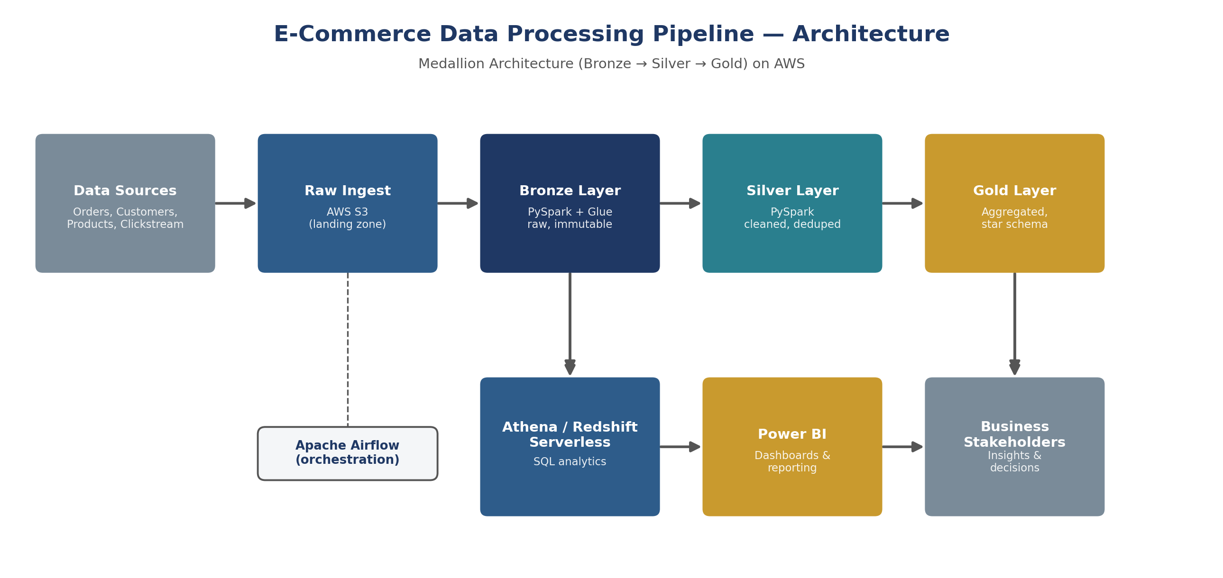
Pipeline Architecture
Medallion architecture (Bronze → Silver → Gold) on AWS
Apache Airflow orchestrates the daily run — triggering S3 ingestion, sequencing the Glue jobs, running data-quality checks between stages, and alerting on failure. Every task is idempotent and safely re-runnable for backfills.
E-Commerce Data Processing Pipeline
3

Slide 4
Medallion Layers
Each layer improves data quality and structure incrementally
BRONZE
SILVER
GOLD
Raw, immutable copy of source data — ingested as-is, schema-enforced.
Deduplicated, null-filtered, type-cast, and conformed against dimensions.
Aggregated, business-level star schema optimized for BI consumption.
STORAGE FORMAT
STORAGE FORMAT
STORAGE FORMAT
Parquet on S3, partitioned by date
Parquet on S3, partitioned by entity
Parquet on S3 + Redshift Serverless / Athena
E-Commerce Data Processing Pipeline
4

Slide 5
Data Sources & Schema
Four core entities land daily in the S3 landing zone
Entity | Grain | Key Fields
orders | 1 row per order line | order_id, customer_id, product_id, order_date, qty, unit_price, status
customers | 1 row per customer | customer_id, name, email, signup_date, region, segment
products | 1 row per SKU | product_id, category, sub_category, brand, cost_price, list_price
clickstream | 1 row per event | session_id, customer_id, event_type, product_id, event_ts
Gold Layer Star Schema
fact_orders sits at the center, joined to conformed dimensions dim_customer, dim_product, and dim_date — optimized for fast aggregation queries in Athena / Redshift Serverless.
E-Commerce Data Processing Pipeline
5

Slide 6
Technology Stack
Cloud-native, cost-efficient, and built for scale
STORAGE
PROCESSING
ORCHESTRATION
AWS S3
PySpark + AWS Glue
Apache Airflow
Partitioned Parquet data lake
Distributed, managed Spark ETL jobs
Scheduling, retries, and alerting
QUERY / WAREHOUSE
LANGUAGE
BI / REPORTING
Athena / Redshift Serverless
Python + SQL
Power BI
SQL analytics on the Gold layer
Transformation logic & analytics queries
Stakeholder-facing dashboards
E-Commerce Data Processing Pipeline
6

Slide 7
Bronze Layer — Raw Ingestion
PySpark on AWS Glue: schema-enforced ingestion from S3 landing to Bronze
from pyspark.sql import SparkSession
from pyspark.sql import functions as F
spark = SparkSession.builder.appName("bronze_ingest").getOrCreate()
schema_orders = "order_id STRING, customer_id STRING, product_id STRING, " \
"order_date STRING, qty INT, unit_price DOUBLE, status STRING"
df = (spark.read
.option("header", True)
.schema(schema_orders)
.csv("s3://ecom-landing/orders/"))
df = (df
.withColumn("ingest_ts", F.current_timestamp())
.withColumn("ingest_date", F.to_date("order_date")))
(df.write
.mode("append")
.partitionBy("ingest_date")
.parquet("s3://ecom-datalake/bronze/orders/"))
E-Commerce Data Processing Pipeline
7

Slide 8
Silver Layer — Cleaning & Conforming
Deduplication, null-handling, and referential integrity checks
bronze = spark.read.parquet("s3://ecom-datalake/bronze/orders/")
silver = (bronze
.dropDuplicates(["order_id"])
.filter(F.col("customer_id").isNotNull() & F.col("product_id").isNotNull())
.withColumn("status", F.lower(F.trim(F.col("status"))))
.withColumn("order_amount", F.round(F.col("qty") * F.col("unit_price"), 2))
.filter(F.col("qty") > 0)
)
valid_customers = spark.read.parquet("s3://ecom-datalake/silver/customers/") \
.select("customer_id")
silver = silver.join(valid_customers, on="customer_id", how="inner")
(silver.write
.mode("overwrite")
.partitionBy("ingest_date")
.parquet("s3://ecom-datalake/silver/orders/"))
E-Commerce Data Processing Pipeline
8

Slide 9
Gold Layer — SQL Analytics
Athena query on the Gold star schema: revenue by category
SELECT
p.category,
SUM(f.revenue) AS total_revenue,
SUM(f.units_sold) AS total_units,
COUNT(DISTINCT f.customer_id) AS unique_customers
FROM gold.fact_orders f
JOIN gold.dim_product p ON f.product_id = p.product_id
WHERE f.order_date >= date_add('month', -3, current_date)
GROUP BY p.category
ORDER BY total_revenue DESC;
E-Commerce Data Processing Pipeline
9

Slide 10
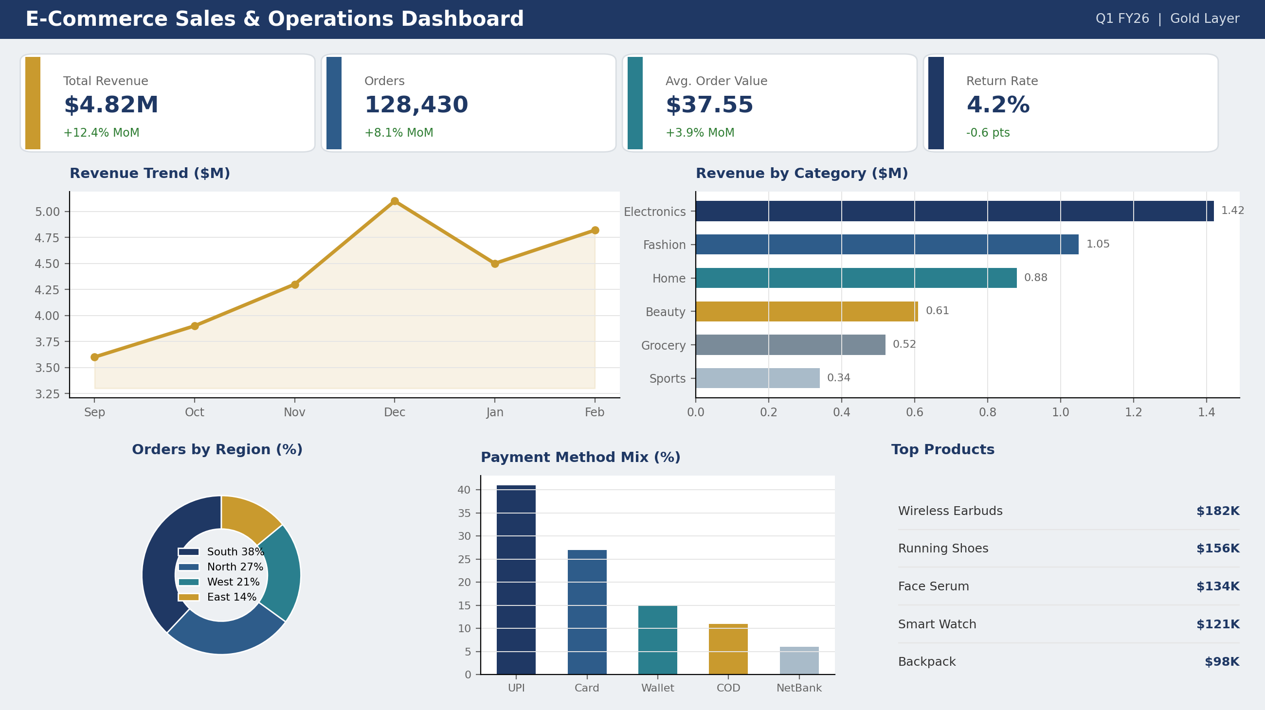
Power BI Dashboard
Refreshed daily via Athena connector, feeding the Gold layer
E-Commerce Data Processing Pipeline
10

Slide 11
Results & Business Impact
Measured before vs. after pipeline adoption
Metric | Before Pipeline | After Pipeline
Time to produce revenue report | ~2 days (manual Excel) | < 15 minutes (automated)
Data quality issues (dup/null rows) | ~7% of records | < 0.5% of records
Analyst query latency | Full table scan on raw CSV | Sub-5s on partitioned Parquet via Athena
Reporting cadence | Weekly, manual | Daily, automated refresh
Data quality improvement
Report turnaround time
E-Commerce Data Processing Pipeline
11

Slide 12
Challenges, Learnings & Conclusion
Challenges & Learnings
Conclusion
Schema drift in raw CSV drops — fixed with explicit schema enforcement at Bronze
Late-arriving customer records caused Silver join failures — nightly reconciliation job
S3 small-file problem from frequent writes — mitigated via Gold-layer compaction
High Athena query costs — reduced via date partitioning + columnar Parquet
This pipeline demonstrates a production-style approach to e-commerce data engineering: a governed, layered data lake; reusable PySpark/Glue transformation logic; a query-optimized star schema; and a business-facing BI layer.
The design is cloud-native, cost-efficient, and extensible — new sources (e.g. marketing spend, support tickets) can be added as additional Bronze ingestion jobs without disrupting downstream Silver/Gold logic.
Naimuddin Khan | Data Engineer | nu0396975@gmail.com | github.com/naimuddin801
E-Commerce Data Processing Pipeline
12

